Slide 1
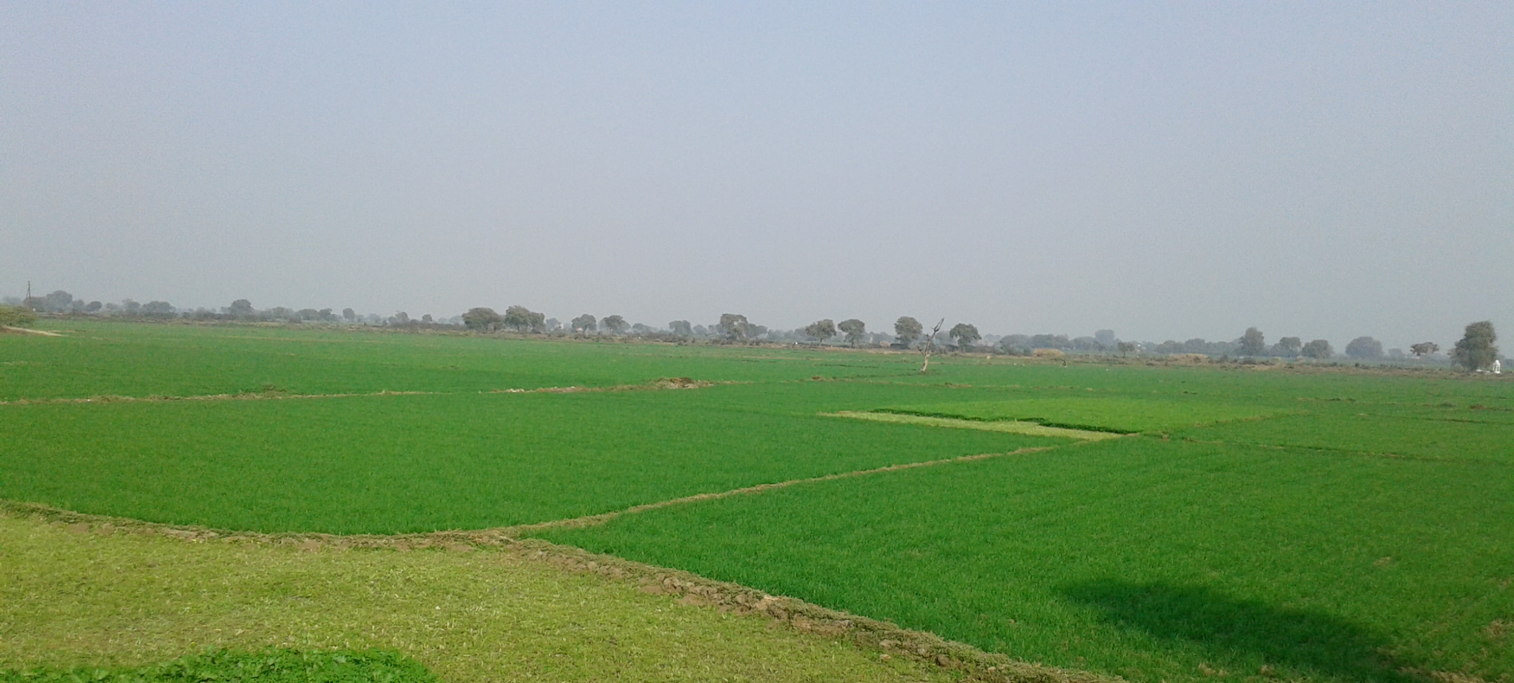

KRISHI FREAK
(IIIT-BANGALORE)
KAVISH AGNIHOTRI
JAGMEET SINGH
SHEFALI BEDARKAR
JITESH NEMADE
HARSHKUMAR PADHYA
AMANDEEP GOYAL

Slide 2
Problem Statement
Estimation of crop yield using model ICT tools which is quick and reliable for making a realistic plan for procurement and to compensate farmers for yield loss if any.
Government of Bihar
Agriculture & Rural Development.
Organization
Domain

Slide 3
About Crop Yield Prediction
Crop yield prediction is of great importance to global food production. Policy makers rely on accurate predictions to make timely import and export decisions to strengthen national food security.

Slide 4
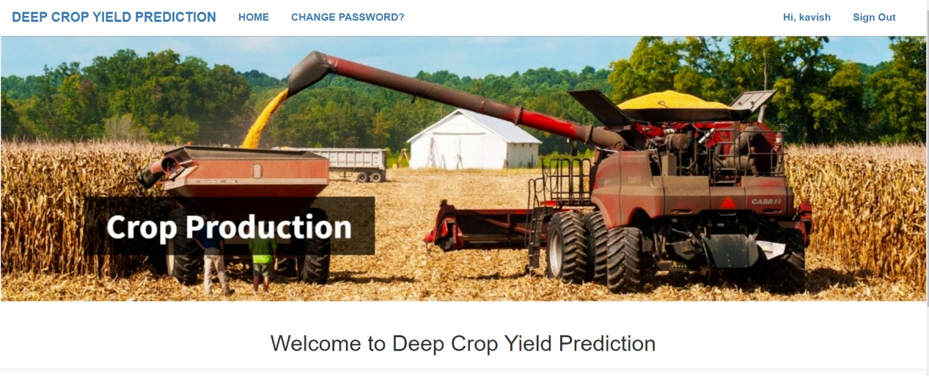
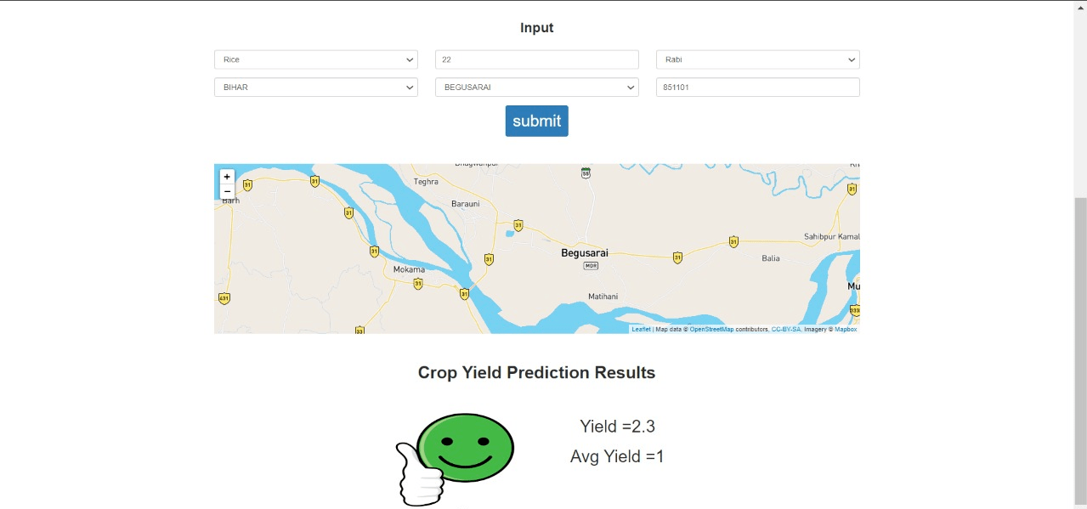
FRONT END
(HTML,CSS,JAVASCRIPT,BOOTSTRAP)

Slide 5
DEMO

Slide 6


Slide 7


